Slide 1
Network Programming
Tutorial 1

Slide 2
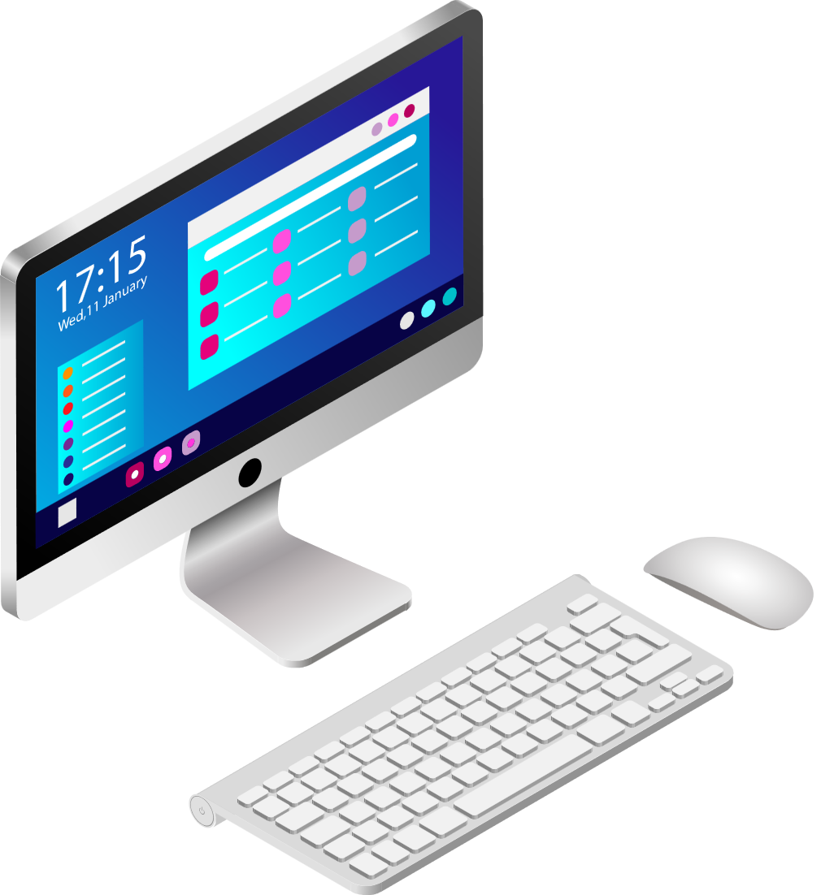
Socket and Process Communiaction
The interface that the operating system provides to its networking subsystem
Socket
User
Process
Internet
User
Process
Application Layer
Application Layer
Transport Layer
Transport Layer
Network Layer (IP)
Network Layer (IP)
Link Layer
Link Layer
Networks
Physical Layer
Physical Layer
Notes:
At the top, we have the application layer — that’s our program, like a chat app or a game.
Below that is the transport layer, which makes sure our data goes from one program to another. That’s where TCP and UDP live.
Then the network layer, which uses IP addresses to find the right machine. The link layer is responsible for local delivery — just from your machine to the next machine on the same network, like your router.
Finally, the physical layer, which is just the cables or Wi-Fi.
Now, how does our program actually send and receive data? That’s where sockets come in.

Slide 3
Socket: End point of Communication
Socket
Sending message from one process to another
Message must traverse the underlying network(s)
Process sends and receives through a “socket”
  Similar to reading and writing to a file
Socket as an Application Programming Interface
  Supports the creation of network applications
User Process
User Process
Socket
Socket
OS
OS
Notes:
A socket is like a door on a house. If the house is the computer, then the door is how information goes in and out.

Slide 4
Type of Communication
Datagram socket (aka UDP):
  Messages
  Best effort (no guarantee of delivery)
  Connectionless
1
Stream socket (aka TCP):
Stream of bytes
Reliable
Connection-oriented (need to establish connection first)
2
Notes:
UDP is very simple: you just send a message, and that’s it. There is no setup, no confirmation, no guarantee that it arrives.
Think of it like sending a postcard. You write your message, put it in the mailbox, and hope it gets delivered. Maybe it arrives, maybe it gets lost, maybe two postcards arrive out of order. But it’s quick and easy.
That’s why UDP is used for things like games, video calls, or streaming, where speed matters more than perfection.
TCP is more reliable, but also a bit heavier.
TCP is connection-oriented. This means the client and server first establish a connection — a handshake — before sending data.
TCP also guarantees that data arrives, and in the right order. If something is lost, it automatically resends it.
The analogy here is a phone call. First you dial, the other person picks up, and then you can have a continuous, reliable conversation. If you don’t hear something, you can say, ‘please repeat’, and TCP handles that automatically.

Slide 5
Socket Identification
Type of protocol
  - Stream
  - Datagram
Host identifier
- Typically, an IP address
  - An Internet Protocol (version 4) address is a 32-bit unsigned integer
Process identifier
  - Host usually runs different processes
  - A port number uniquely identifies process
  - A port number is a 16-bit unsigned integer
1
2
3
Notes:
Every socket has two identifiers:
An IP address: which house.
A port number: which person inside the house.

Slide 6
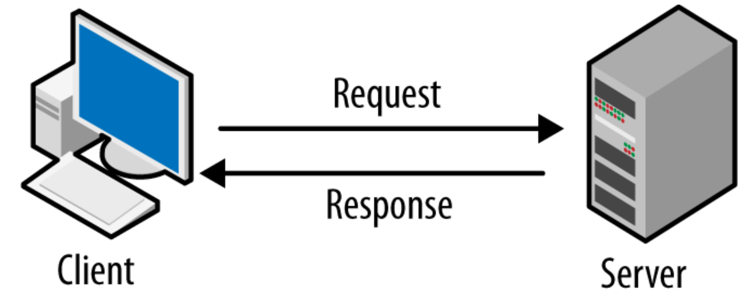
Client and Server Processes
Client process initiates communication
Server process waits to be contacted
Notes:
And finally, we usually have two roles: the server, which sits and waits at its door, and the client, which is the one that knocks first.

Slide 7
Server “Location”
Client needs to know:
Server host identifier
What is the server host address?
Server process identifier
What is the process port number?
We can translate … this is “name resolution”
Machines Prefer numbers
VS
Human Like Names
Example: web server piazza.com is host with IP address 54.243.185.105, and web service uses port number 80
Notes:
Domain Name System (DNS)
Example:
If I go to piazza.com, my computer first finds the IP address for that domain. Let’s say it’s 54.243.185.105. Then it connects to port 80 on that machine, because that’s where the web server is waiting.

Slide 8
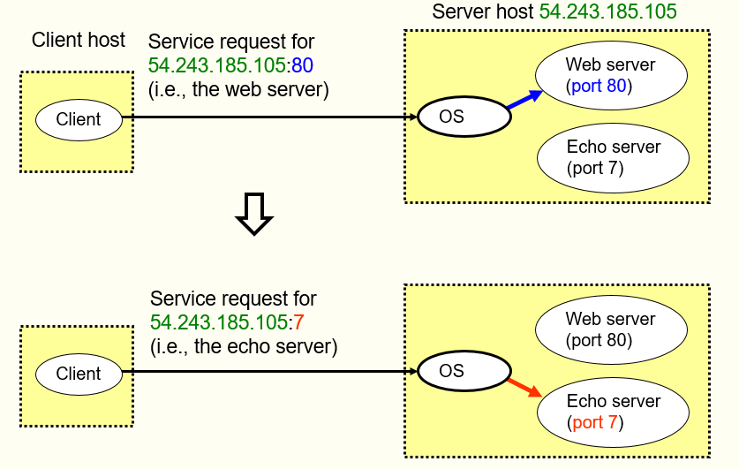
Using Ports to identify Services
Notes:
The port number tells us which program inside the house should receive the message.
So:
IP address = house address.
Port = person’s name on the mailbox.
For example:
A web server usually lives on port 80. So if you connect to port 80, you’re basically saying: ‘Hey, I want to talk to the web server program in this house.’
An echo server might live on port 7. That’s a little program that just repeats back whatever you send it.
So the combination of IP address + port uniquely identifies the socket you’re talking to.

Slide 9
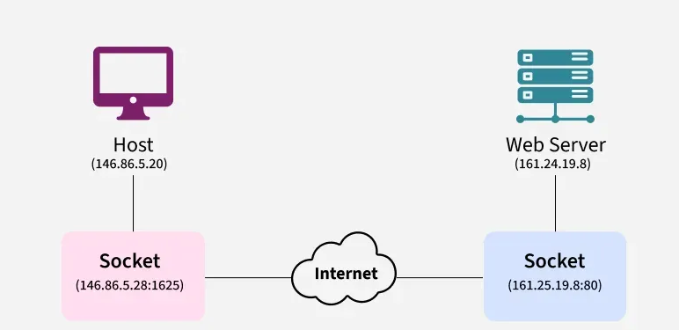
Client-Server Communication Datagram Sockets: Connectionless

Slide 10
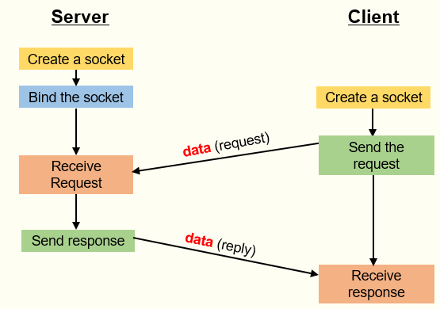
Client-Server Communication Datagram Sockets: Connectionless

Slide 11
Let’s Code
Notes:
UDP RTT code
Let’s do our first exercise: measuring round-trip time with UDP.
The idea is:
The client sends a message to the server.
The server immediately sends it back.
The client measures how long that round trip took.
This is like mailing a postcard and timing how long it takes until you get a reply.
We’ll build this code skeleton together, step by step.

Slide 12
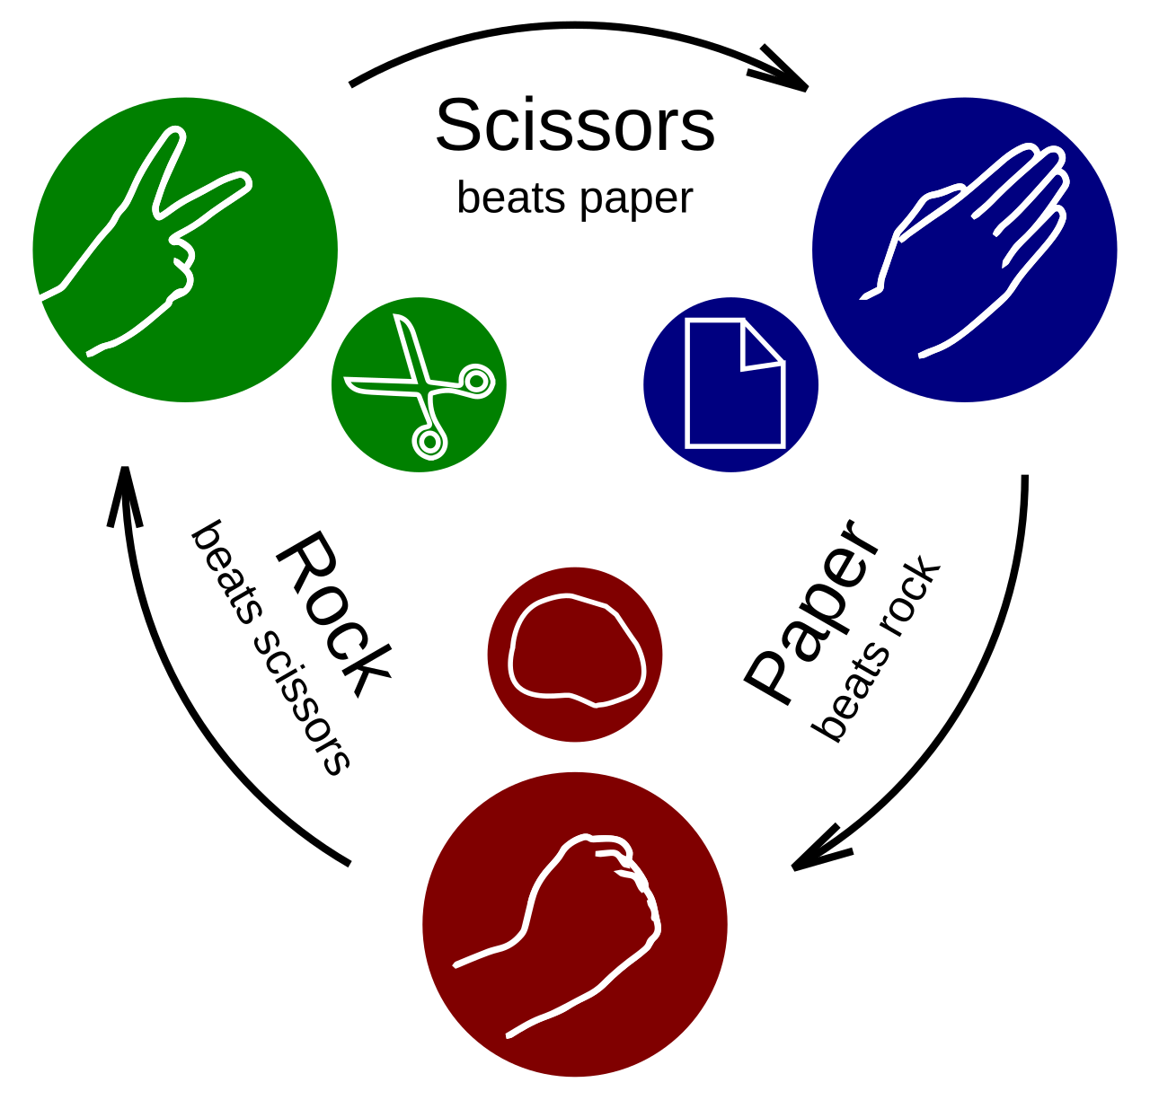
Your Turn ! (Part 1)
Write a rock, paper, scissors game as a client-server application.
The client should play the game with the server (i.e. the server randomly generates his own choice, and the client inputs his choice and sends it to the server)
Compute the round-trip time (time elapsed from sending the choice to receiving the server’s reply).
Make use of the time module (look it up online)
Use the UDP protocol
Notes:
Now it’s your turn to extend the skeleton into a little game: rock, paper, scissors.
Here’s the plan:
The server randomly picks rock, paper, or scissors.
The client sends its choice.
The server replies with the result: win, lose, or draw.
It’s still UDP, so no handshake, no connection — just quick message exchanges.

Slide 13
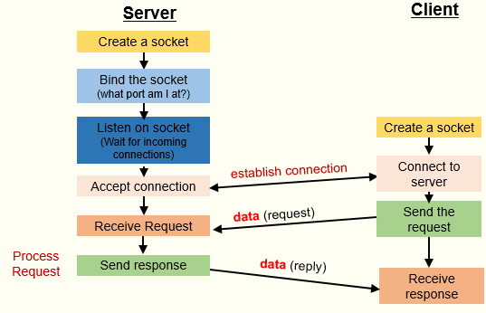
Client-Server Communication Stream Sockets: Connection-Oriented

Slide 14
Stream vs Datagram Socket
Operation | Stream socket | Datagram socket
Creating the socket | socket.socket(socket.AF_INET, socket.SOCK_STREAM) | socket.socket(socket.AF_INET, socket.SOCK_DGRAM)
Connecting | ***.connect((“IP”, “Port”)) # client ***.listen() and *.accept() # server | N/A
Sending | ***.send(“encoded message”) | ***.sendto(“encoded message”, (address))
Receiving | ***.recv(#buffer size) | ***.recvfrom(1024)

Slide 15
Let’s Code
Notes:
TCP RTT code
Let’s repeat our round-trip time experiment, but now with TCP.
This time:
The client first connects to the server.
Then the client sends a message.
The server echoes it back.
And the client measures how long it took.
So this is like timing a message during a phone call, instead of using postcards

Slide 16
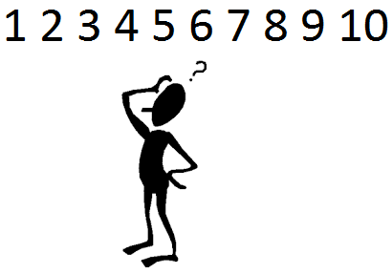
Your turn! (Part 2)
Write a number guessing game as a client-server application.
Let the server generate the number and give the user multiple tries to guess the number.
Use the TCP protocol.
Notes:
Now it’s your turn again. Let’s build a number guessing game using TCP.
Here’s how it works:
The server secretly picks a number.
The client keeps sending guesses.
The server replies with one of three answers: ‘too high’, ‘too low’, or ‘correct’.
The game continues until the client guesses correctly.
This is a great way to practice sending and receiving multiple messages in a row.

Slide 17
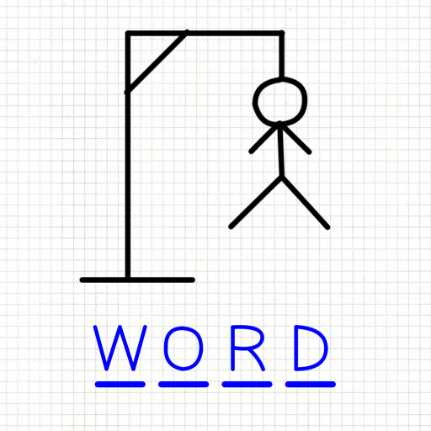
Practice Exercise
Develop a hangman game as a client-server application using either TCP or UDP (try doing it with both).
Define a list of words on the server’s side. Whenever a client connects, let the server choose a word at random.
The server should inform the player if the entered letter is in the word. The server should also send a string showing the position of the found letters and representing the unfound letters by an asterisk *
Notes:
Finally, for those of you who finish early, here’s a bonus challenge: Hangman.
The server has a list of words and picks one at random.
The client sends letter guesses.
The server replies with the progress — for example, if the word is cat and the client guesses ‘c’, the server sends back ‘c * t’.
The game continues until the word is guessed or the player runs out of attempts.
Try it with TCP first, since it’s easier. If you’re feeling adventurous, try it with UDP too.

